Slide 1

Line Parameters and Line Models
EE 471 POWER SYSTEM ANALYSIS I

Slide 2
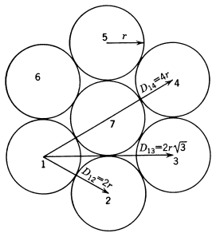

Home work solutıon

Slide 3
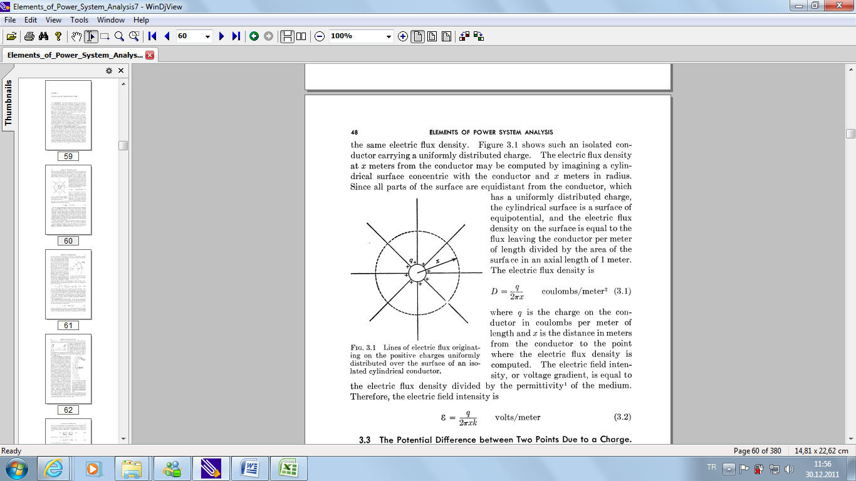


CAPACITANCE OF TRANSMISSION LINES
The cylindrical surface is a surface of equipotential, and the electric flux density on the surface is equal to the flux leaving the conductor per meter of length divided by the area of the surface in an axial length of 1 meter. The electric flux density is
The electric field intensity, or voltage gradient, is equal to the electric flux density divided by the permittivity of the medium. Therefore, the electric field intensity is
Lines of electric flux originating on the positive charges uniformly distributed over the surface of an isolated cylindrical conductor.
ε = F/m

Slide 4
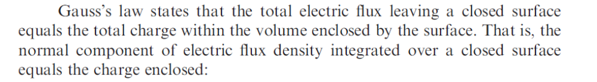
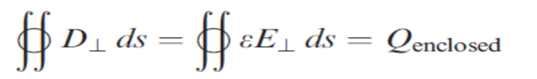
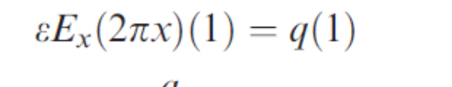
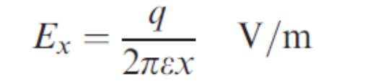
Gauss Law
Consider the cylindrical surface with radius x and length of 1m
and apply Gauss Law

Slide 5
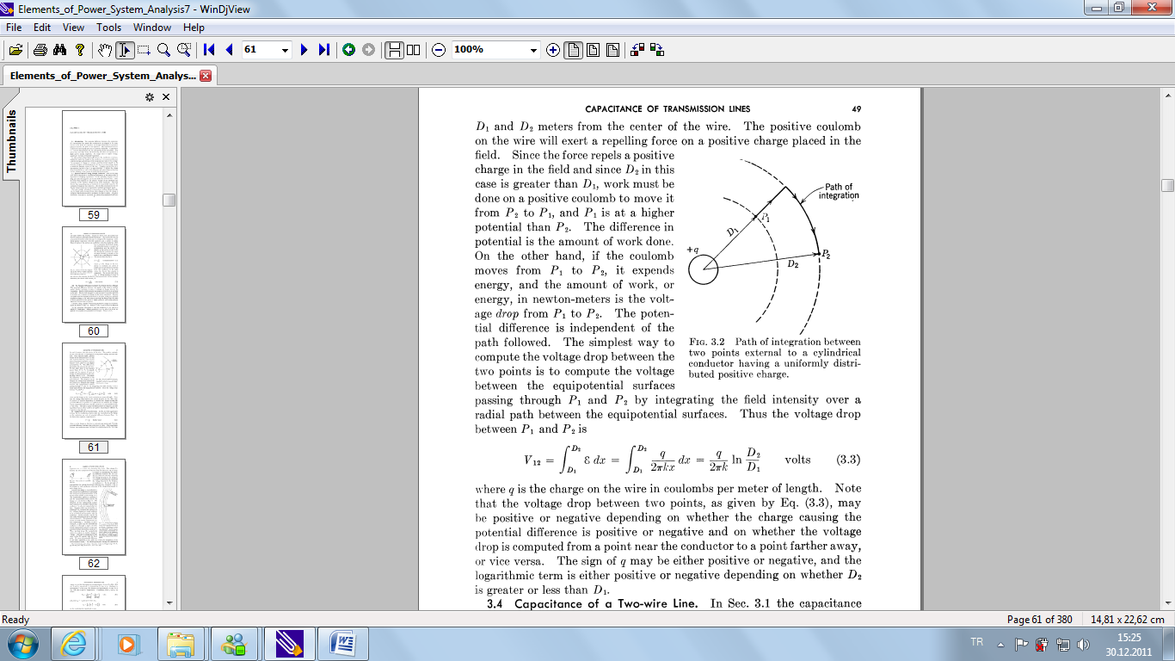

The Potential Difference between Two Points Due to a Charge

Slide 6
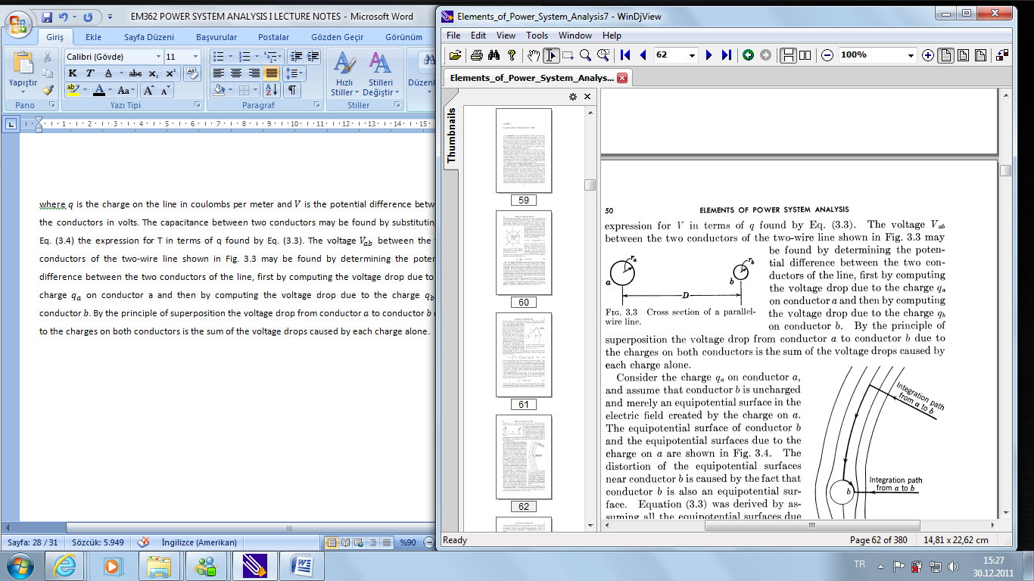




Capacitance of a Two-wire Line
where q is the charge on the line in coulombs per meter and V is the potential difference between the conductors in volts.
By superposition assume charge on conductor b is zero and calculate the potential difference. Then assume charge on conductor a is zero and calculate the potential difference.
Then
Cross section of a parallel- wire line.
and, since q_{a}=-q_{b} for a two-wire line,

Slide 7

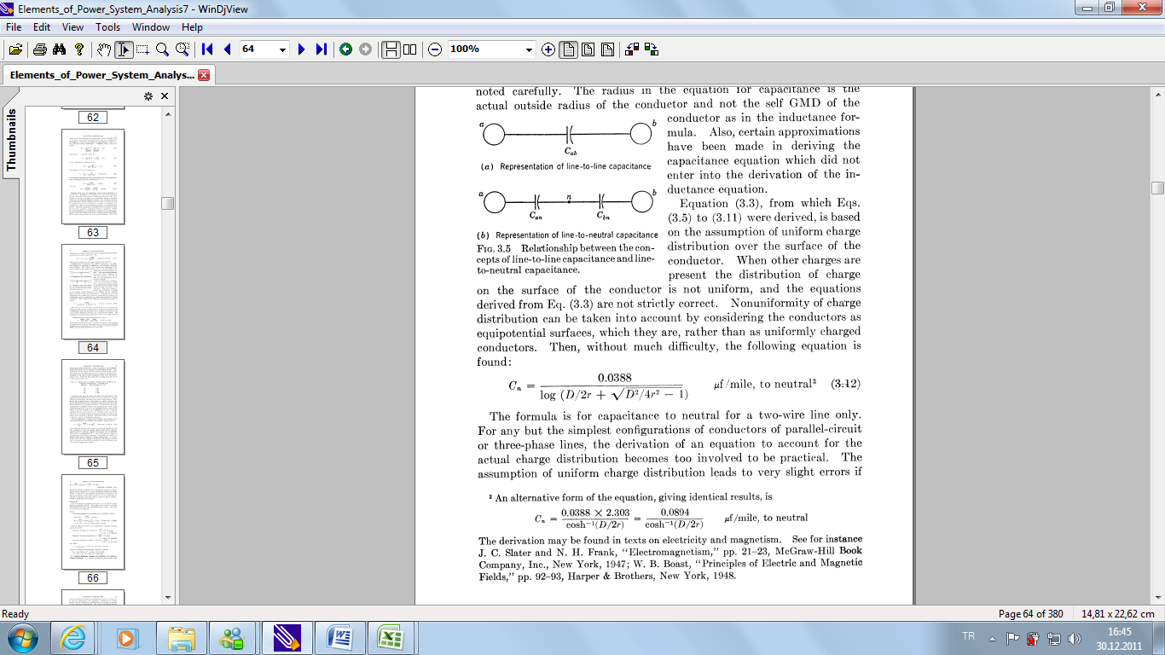

Capacitance of a two wire line
If radius of conductor a is equal to radius of conductor b

Slide 8
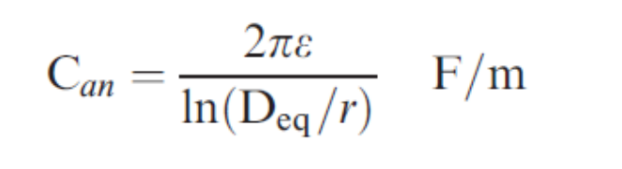

Capacitance Calculation
GMD concept also applies for capacitance calculations.
Note that r is used rather than r x 0.7788 since for the solid conductor internal capacitance does not exist

Slide 9
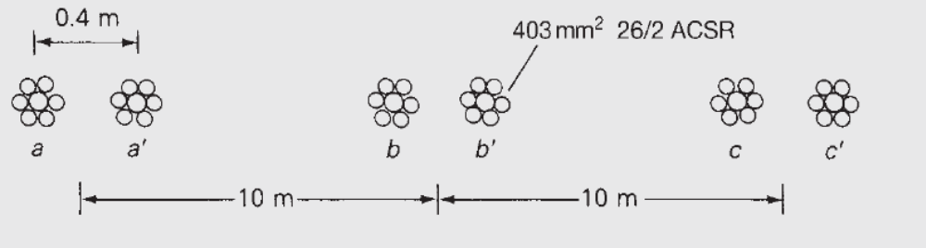
EXAMPLE
Length is 200 km , f =60 Hz , r= 0.0141 for 26/2 ACSR
For the three phase line find the shun admittance to neutral in S. If the line voltage is 345 KV, determine
the charging current In kA per phase.

Slide 10

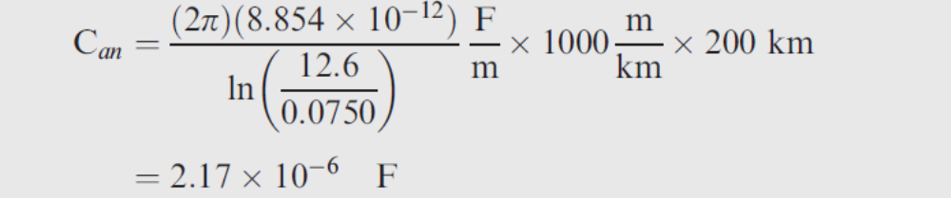
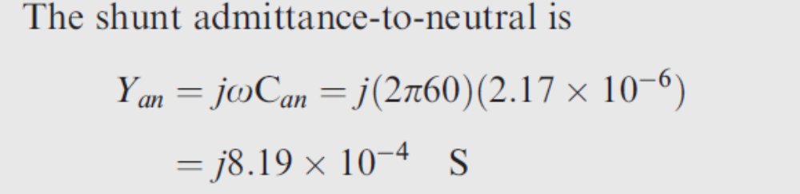
Example Solution

Slide 11
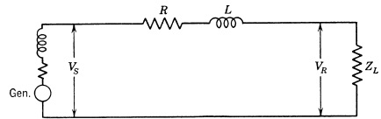
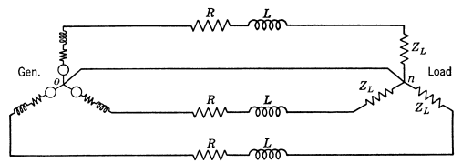
CURRENT AND VOLTAGE RELATIONS ON A TRANSMISSION LINE
Normally, transmission lines are operated with balanced three-phase loads. Although the lines are not spaced equilaterally and may not be transposed, the resulting dissymmetry is slight, and the phases are considered to be balanced
Generator supplying a balanced- Y load through a transmission line
Single-phase equivalent of the circuit

Slide 12
Line Classification
The classification of power transmission lines according to length depends upon what approximations are justified in treating the parameters of the line. Resistance, inductance, and capacitance are uniformly distributed along the line, and exact calculations of long lines must recognize this fact
Medium length lines are roughly between 80 and 160 kms long. Lines shorter than 80 kms is considered as a short line.Lines more than 160 kms long may require calculation in terms of distributed constants if a high degree of accuracy is required. However cascaded circuits modelling the medium length line can also be used.
In order to distinguish between the total series impedance of a line and the series impedance per unit length, the following nomenclature is adopted:
z = series impedance per unit length, per phase
y = shunt admittance per unit length, per phase to neutral
l= length of the line
Z = zl = total series impedance per phase
Y = yl = total shunt admittance per phase to neutral

Slide 13
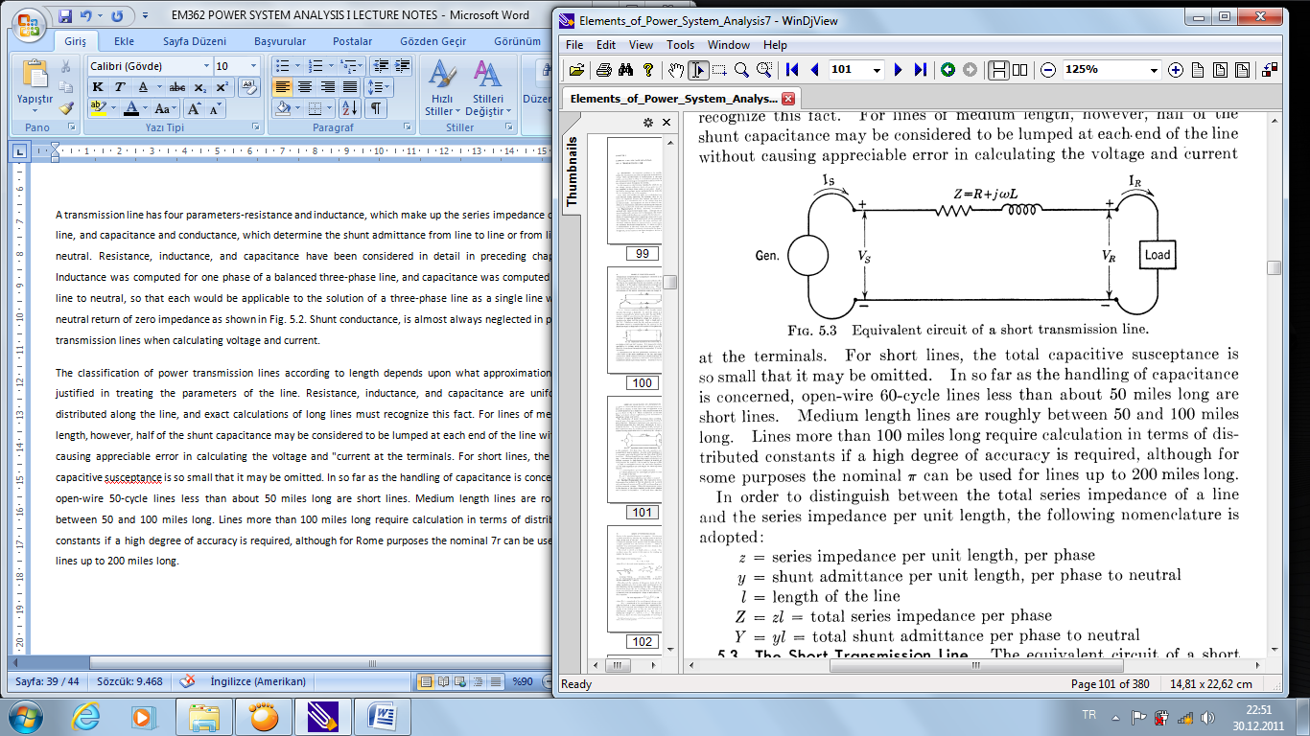
The Short Transmission Line
The circuit is solved as a simple series a-c circuit. Since there are no shunt arms, the current is the same at the sending and receiving ends of the line, and
The voltage at the sending end is
where Z is zl, the total series impedance of the line.

Slide 14


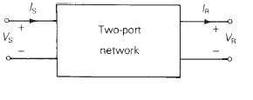
Short Line Current Voltage Relationships

Slide 15

Voltage Regulation
Voltage regulation of a transmission line is the rise in voltage at the receiving end, expressed in per cent of full load voltage when full load at a specified power factor is removed while the sending-end voltage is held constant. In the form of an equation
where magnitude of the receiving-end voltage at no load
magnitude of the receiving-end voltage at full load

Slide 16
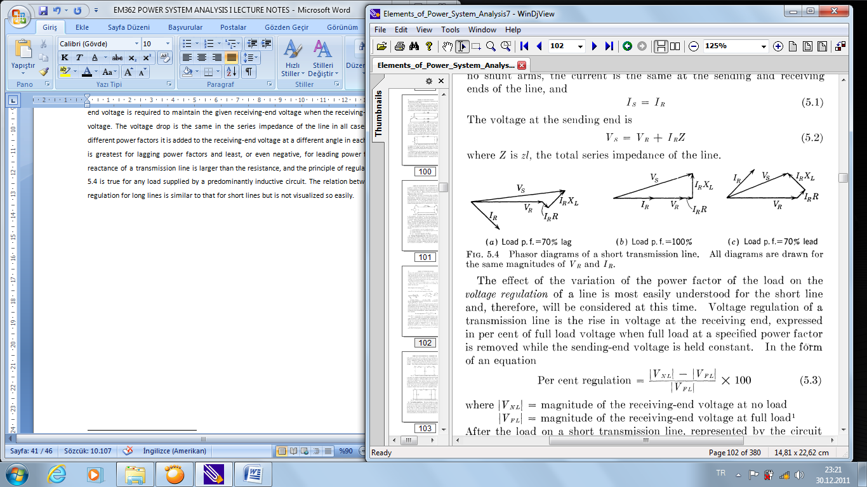
Phasor diagrams of a short transmission line

Slide 17
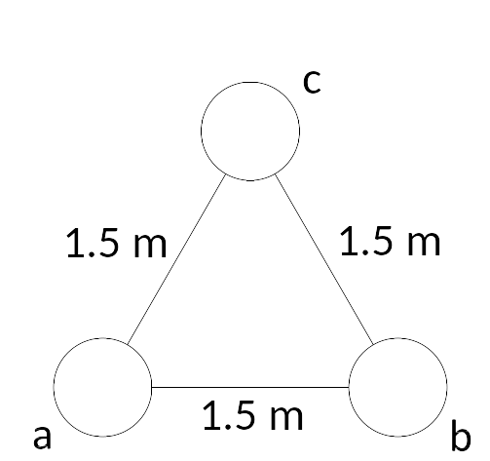
EXAMPLE
A three phase 50 Hz transmission line has a length of 20 km. The phases of the lines are spaced according to figure. When the distances between phases are 1.5 m and r’=0.508 cm, R=1.72x10⁻⁴ Ω/m. 2500 kW is delivered to the load when the load voltage is 11 kv (line-to-line).
Find V_{s} for,
a. Load p.f.=0.6 lagging
b. Load p.f. is unity
c. Find voltage regulation

Slide 18




EXAMPLE

Slide 19



Solution
b) Load p.f. =1

Slide 20
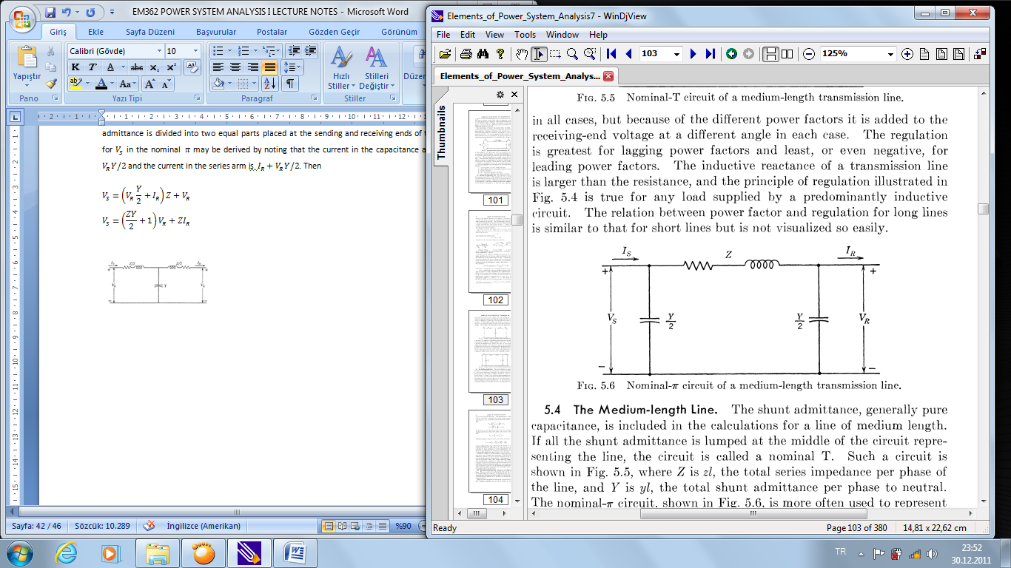
. The Medium-length Line
In the nominal-π circuit the total shunt admittance is divided into two equal parts placed at the sending and receiving ends of the line. The equation for V_{S} in the nominal π may be derived by noting that the current in the capacitance at the receiving end is V_{R}Y/2 and the current in the series arm is I_{R}+V_{R}Y/2. Then
Nominal –π Circuit Model

Slide 21




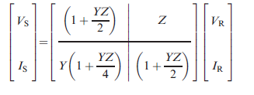
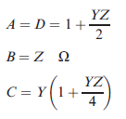
Nominal - π Model

Slide 22


Nominal- circuit of a medium-length transmission line
To derive I_{S} we note that the current in the shunt capacitance at the sending end is V_{S}Y/2, which when added to the current in the series arm gives
and substituting V_{S} as given by Eq. (5.5) in Eq. (5.6) gives

Slide 23
Nominal - π Model

Slide 24
EXAMPLE
50 Hz, three phase transmission line
l=100 km
R=0.11 Ω/km
X_{L}=0.38 Ω/km
Y=3.10⁻⁶ Ω⁻¹/km
48 MVA is delivered at 154 kV at the receiving end with p.f. of 0.7 lagging. Find V_{S} with the nominal-π model?

Slide 25




EXAMPLE
Solution:

Slide 26
Home work solutıon

